Slide 1

Voice of Customers
Sentiment Analysis using NLP

Slide 2
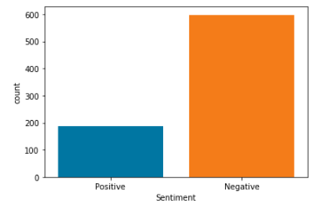
Use Case: Voice Of Customer
Part 1: Review comments from the customer facing application will be analyzed for polarity[Positive & Negative sentiments]
Part 2: Identify specific modules in the application that were reported with negative sentiment
Review Comments from Play Store has been extracted using Web Scrapping for Fly Delta and Air Canada Application
Total Number of Records Used – 785
INPUT
Review Comments were extracted from Fly Delta and Air Canada applications using web scrapping in .csv format.
OUTPUT
After Processing the Review comments, Sentiment polarity of the review comments are predicted.

Slide 3
Approach taken – Voice of customer
Data Extraction
Text Preprocessing
Data Modelling
Model Evaluation
Sentiment Prediction
Part – 1 – Sentiment Analysis
Output of Part 1
Text Preprocessing
Data Modelling
Model Evaluation
Categorization of Negative Review comments
Part – 2 – Topic Modelling

Slide 4
Sentiment Analysis – Detailed Approach
Data Extraction
Extracting Review Comments from Customer facing application using Web Scrapping
Text Preprocessing
Removal of punctuations, digits and extra spaces
Data Modelling
Logistic Regression
Text Normalization and lemmatization
Random Forest
XG Boost
Naïve Bias
Bi-Directional LSTM
Model Evaluation
Accuracy
Confusion Matrix
Classification Report
F1 Score
AUC Curve
Sentiment Prediction
Predicting Sentiment for the reviews and validating

Slide 5

Categorization – Topic Modelling

Slide 6
Topic Modelling – Detailed Approach
Output of Part-1
Output from Sentiment Analysis will be input for Topic Modelling
Text Preprocessing
Removal of punctuations, digits and extra spaces
Data Modelling
Topic Modelling using LDA
Text Normalization and lemmatization
Sentiment with Negative values are taken.
NMF
Categorization
Categorization of Data using various Topics

Slide 7
Recommendations – Best practices for Voice of customer
From various Machine Learning Models, Naïve Bayes has been finalized for the below reasons,
Model is predicting less number of False positives (i.e predicting Negative sentiment as Positive) than other models.
It has good accuracy and AUC Score
Bidirectional LSTM has been finalized for sentiment Analysis for the below reasons,
It has good accuracy and AUC Score
As the data propagation flow is from past to future and future to past, it will learn about the data completely better than other model.

Slide 8
Conclusion
Sentiment Analysis using Machine learning and Deep learning approaches are completed and Best Models have been identified
Topic Modelling using the output of Sentiment Analysis is in progress.
Risks :
When the data imbalance, the accuracy of the Sentiment analysis model will be affected
Data used for Topic Modelling is small, hence the words are presented in multiple topics. Increasing the data size may reduce the repetition of words in multiple topics Topic Modelling using the output of Sentiment Analysis is in progress.

Slide 9

Thank you

Slide 10
Machine Learning Approaches & Results

Slide 11
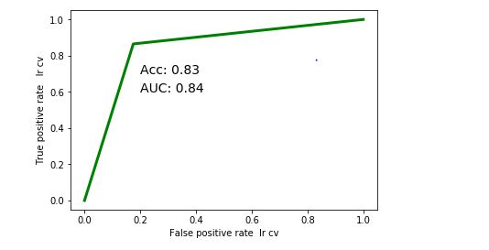
Logistic Regression – Count Vectorizer
Logistic Regression is a Predictive Analysis that can be used when the target variable is Binary.
The CountVectorizer provides a simple way to both tokenize a collection of text documents and build a vocabulary of known words, but also to encode new documents using that vocabulary.
Accuracy is 83.44%
Classification Report | Precision | Recall | F1 – Score | Support
0 | 0.95 | 0.82 | 0.88 | 120
1 | 0.60 | 0.86 | 0.71 | 37
Accuracy |  |  | 0.83 | 157
Macro Avg | 0.78 | 0.84 | 0.80 | 157
Weighted Avg | 0.87 | 0.83 | 0.84 | 157
AUC | 0.844932432432432

Slide 12
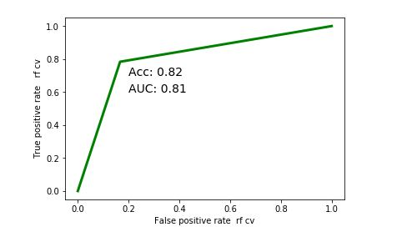
Random Forest – Count Vectorizer
Random forest consists of a large number of individual decision trees that operate as an ensemble. Each individual tree in the random forest spits out a class prediction and the class with the most votes becomes our model’s prediction
The CountVectorizer provides a simple way to both tokenize a collection of text documents and build a vocabulary of known words, but also to encode new documents using that vocabulary.
Accuracy is 82.17%
Classification Report | Precision | Recall | F1 – Score | Support
0 | 0.93 | 0.83 | 0.88 | 120
1 | 0.59 | 0.78 | 0.67 | 37
Accuracy |  |  | 0.82 | 157
Macro Avg | 0.76 | 0.81 | 0.78 | 157
Weighted Avg | 0.85 | 0.82 | 0.83 | 157
AUC | 0.808558558558558

Slide 13
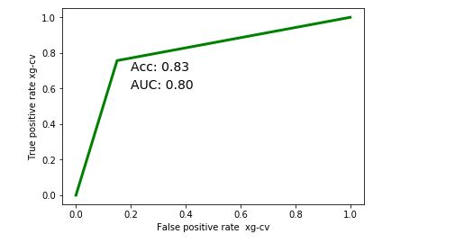
XG Boost– Count Vectorizer
XGBoost is an optimized gradient boosting algorithm through parallel processing, handling missing values and and regularization to avoid overfitting and bias
The CountVectorizer provides a simple way to both tokenize a collection of text documents and build a vocabulary of known words, but also to encode new documents using that vocabulary.
Accuracy is 82.8%
Classification Report | Precision | Recall | F1 – Score | Support
0 | 0.92 | 0.85 | 0.88 | 120
1 | 0.61 | 0.76 | 0.67 | 37
Accuracy |  |  | 0.83 | 157
Macro Avg | 0.76 | 0.80 | 0.78 | 157
Weighted Avg | 0.85 | 0.83 | 0.83 | 157
AUC | 0.8033783

Slide 14
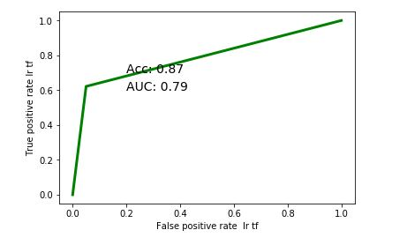
Logistic Regression – TFIDF Vectorizer
Logistic Regression is a Predictive Analysis that can be used when the target variable is Binary.
TfidfVectorizer - Transforms text to feature vectors that can be used as input to estimator
Accuracy is 87.26%
Classification Report | Precision | Recall | F1 – Score | Support
0 | 0.89 | 0.95 | 0.92 | 120
1 | 0.79 | 0.62 | 0.70 | 37
Accuracy |  |  | 0.87 | 157
Macro Avg | 0.84 | 0.79 | 0.81 | 157
Weighted Avg | 0.87 | 0.87 | 0.87 | 157
AUC | 0.78581081081081

Slide 15
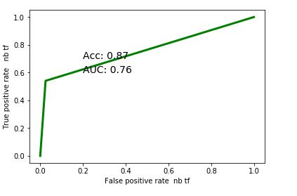
Naïve Bayes – TFIDF Vectorizer
Naive Bayes is a classification algorithm for binary (two-class) and multi-class classification problems. Instead of calculating the value for each attribute, it assumed to be conditionally independent given the target value.
TFIDF Vectorizer - Transforms text to feature vectors that can be used as input to estimator
Accuracy is 87.26%
Classification Report | Precision | Recall | F1 – Score | Support
0 | 0.87 | 0.97 | 0.92 | 120
1 | 0.87 | 0.54 | 0.67 | 37
Accuracy |  |  | 0.87 | 157
Macro Avg | 0.87 | 0.76 | 0.79 | 157
Weighted Avg | 0.87 | 0.87 | 0.86 | 157
AUC | 0.757770270

Slide 16
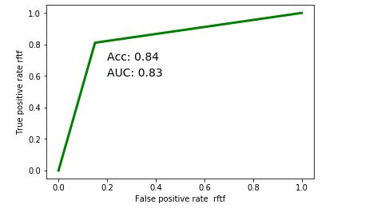
Random Forest – TFIDF Vectorizer
Random forest consists of a large number of individual decision trees that operate as an ensemble. Each individual tree in the random forest spits out a class prediction and the class with the most votes becomes our model’s prediction
TFIDF Vectorizer - Transforms text to feature vectors that can be used as input to estimator
Accuracy is 82.17%
Classification Report | Precision | Recall | F1 – Score | Support
0 | 0.94 | 0.85 | 0.89 | 120
1 | 0.62 | 0.81 | 0.71 | 37
Accuracy |  |  | 0.84 | 157
Macro Avg | 0.78 | 0.83 | 0.80 | 157
Weighted Avg | 0.86 | 0.84 | 0.85 | 157
AUC | 0.830405

Slide 17
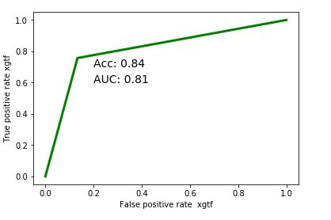
XG Boost– TFIDF Vectorizer
XGBoost is an optimized gradient boosting algorithm through parallel processing, handling missing values and and regularization to avoid overfitting and bias
TFIDF Vectorizer - Transforms text to feature vectors that can be used as input to estimator
Accuracy is 84.08%
Classification Report | Precision | Recall | F1 – Score | Support
0 | 0.92 | 0.87 | 0.89 | 120
1 | 0.61 | 0.76 | 0.69 | 37
Accuracy |  |  | 0.84 | 157
Macro Avg | 0.78 | 0.81 | 0.79 | 157
Weighted Avg | 0.85 | 0.84 | 0.85 | 157
AUC | 0.811711

Slide 18
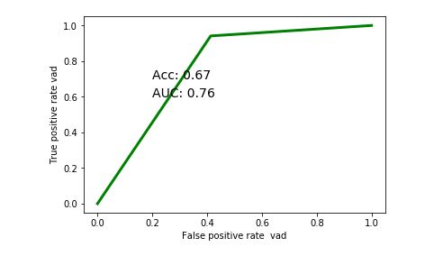
Lexicon Model - Vader
A lexicon model typically uses a lexicon, also known as a dictionary or vocabulary of words specifically aligned to sentiment analysis. It can be used to compute the sentiment of a text document by matching the presence of specific words from the lexicon and then looking at other factors like presence of negation parameters, surrounding words, overall context, phrases, and aggregate overall sentiment polarity scores to decide the final sentiment score
The VADER lexicon is based on a rule-based sentiment analysis framework, specifically tuned to analyze sentiments
Accuracy is 67.13%
Classification Report | Precision | Recall | F1 – Score | Support
0 | 0.97 | 0.59 | 0.73 | 598
1 | 0.42 | 0.94 | 0.58 | 187
Accuracy |  |  | 0.67 | 785
Macro Avg | 0.69 | 0.76 | 0.65 | 785
Weighted Avg | 0.84 | 0.67 | 0.69 | 785
AUC | 0.764066496

Slide 19
Deep Learning Approach

Slide 20
Text Preprocessing
Removing the digits
Removing the puncutation,single char, alpha num,non ascii
Tokenizing the reviews and padding the reviews as the sequences and taking the max length 250 of the text by taking the median of the text length in the train data
Choosing the pretrained model glove with the words of 100dimension vectors

Slide 21
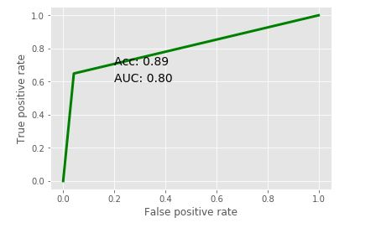
Bi Directional LSTM
Bidirectional LSTM means the Data propagates backward as well as forward in time. Feed the learning algorithm with the original data once from beginning to the end and once from end to beginning. Hence It learns faster than one-directional approach
Accuracy is 88.54%
Classification Report | Precision | Recall | F1 – Score | Support
0 | 0.90 | 0.96 | 0.93 | 120
1 | 0.83 | 0.65 | 0.73 | 37
Accuracy |  |  | 0.89 | 157
Macro Avg | 0.86 | 0.80 | 0.83 | 157
Weighted Avg | 0.88 | 0.89 | 0.88 | 157
AUC | 0.803490

